Slide 1
How do economists approach problems?
What economists study and how they study it?
What is more dangerous, a gun or a swimming pool?
(1) Why is economics difficult?
There are three ways to express ideas in economics:
1. English language
2. Algebra / equations
3. Diagram / graph
You must be able to translate between each different form of communication
price
Demand does down
quantity
Notes:
(1) Why is economics difficult?
Three ways to express ideas in economics:
Language – sentences and words to describe what is going on in the world
Algebra/equations – a lot more algebra as ↑in economic courses
Diagrams/graph – more in baby economics; less in harder courses b/c easy to draw a 2D diagram, changing only two variables while holding everything else constant BUT if want to allow seven variables change at the same time…can’t draw one diagram and look at that case
Algebra will allow more than 2 things to change at once
Need to be able to translate b/w different forms of communication in economics
When the price of coke goes up, people drink less Coke (sentence expressing an idea) → should be able to write sentence as an equation and draw it as a graph

Slide 2
(2) ECONOMICS is a social science
social = people
science = use scientific method
→observe
→theorize
→test theory
(3) Microeconomics vs Macroeconomics
microeconomics: individual households & firms and how they interact
macroeconomics: economy-wide phenomena such as interest rates, unemployment, money, and growth
Notes:
(2) Economics is a social science
Deals with people = social
Economics is also considered a science. Can’t conduct a lot of experiments (why don’t triple income tax for one year and see what happens? Can’t do this)
Still want to use scientific method to approach economic problems
Make observation in world that is interesting
Theory to explain observation
Collect data to test theory; hard sciences is collected using experiment; social science is collected by existing sources
If data supports theory, move onto another interesting problem to study
If data does not support theory → go back to theory and try to come up with new/improved theory
US is a good economy because every experiment you have 50 states = 50 data points
(3) Microeconomics vs. Macroeconomics
Microeconomics = study of individual households and firms and how they interact with each other
Macroeconomics = economy-wide phenomena such as interest rate, unemployment, money and growth (usually seen in the news)
*Know about US regression

Slide 3
(4) Positive vs Normative analysis
positive is the world ‘as it is’ (FACT)
normative is the world ‘as it should be’ (VALUE JUDGEMENT/OPINION)
(5) Efficiency vs Equity (An important trade-off)
efficiency is the size of the pie (use same ingredients to make a bigger pie)
equity is how the pie is divided
When efficiency increases, equity decreases
Notes:
(4) Positive and Normative analysis
Economists like to say that they conduct mainly positive analysis
Positive statement: description of the world as it is (i.e. the legalization of abortion in US in early 1970s contributed to drop in crime in US in 1990s)
Normative: description of the world as it should be; it makes a value judgment (i.e. abortion is a good thing b/c when legalized in 1970s that helped contribute to drop in crime in 1990s)
See words such as: good, should, ought to be = imply value judgment being made
--------
Lead cause violence in ppl when they smell it
Remove lead from paints/gasoline, then 20 years later, a big drop in violence
Why are the principles 6 & 7 different in the book compared to lecture?
Look at notes from last class and textbook!
Principle #6: Markets are usually a good way to organize economic activity (a normative statement) → this implies that markets are good and other systems of organizing economic activity is not good
It was discussed that there was a trade-off b/w equity and efficiency. Most economists do is place a higher value on efficiency than equity (okay, but know this is happening).
Lecture: Markets tend to increase efficiency (a positive statement)
Principle #7: Government can sometimes improve market outcomes (normative – value judgement)
Lecture: Sometimes government can eliminate market inefficiencies (taken value judgment out of those statements)
Economists tend to have faith in efficiency
Economists don’t acknowledge when we have effciency, we have less equity
(5) Efficiency vs Equity
Markets are not equitable, or else everyone would get a large Tim Hortons coffee.
So who does? People who like coffee, people who are willing to pay (not equitable, but it is more efficient)

Slide 4
(6) Model = simplification
diagram or equations
assumptions
variables
eg. map of a city
(7) Classify variables
real variables vs nominal variables
stock variables vs flow variables
Notes:
(6) Model = simplification
**Know how economists use models to solve problems
Model = simplification of reality
In economics, it involves diagrams, equations, assumptions, variables
Assumptions are usually tricky and must be made b/c the only way a model can be useful when the picture is clear to get an idea that is of interest
Models become more realistic as ↑ economic courses; Basic underlying findings are still true.
Different variables are used in the model to improve understanding
Model example: Want to go from McMaster to downtown Hamilton. Don’t know how to get there. There is a map; scale is 1km = 1km. Every tree, sign, fire hydrant is on the map. Map is useless because it is NOT a simplification of reality; it is a duplication of reality. The only way a map is useful is to make it smaller and simpler than real life.
(7) Classify variables
Variables can be classed in many different ways
Determine whether the variable is real or nominal
Real variable: measured in physical units or relative to other variables (i.e. a coffee at Tim Hortons cost 1/3 of a grande at Starbucks; measuring in physical variables such as litres, metres, feet, or in terms of another variable)
Nominal variable: measured in dollars (i.e. a coffee at Tim Horton’s cost $1.18)
See how these variables compare to time
Stock variable: snapshot at a point in time (i.e. bathtub filling, the amt of water at a given time; could be measured in litres, gallons, other measure of volume)
→ wealth is stock variable, capital is stock
Flow variable: has a time dimension to it (i.e. the rate water coming from tap into the tub; i.e. if turn tap off, take plug out, rate water is leaving)
Flow variables add to or take away from stock variables
→ savings per month is flow, investments is flow (measured by time b/c it increases)

Slide 5
Revenue
Spending/Expenditures
Markets for Goods & Services
G & S sold
G & S bought
Firms
Households
Factors of production
labour, land, capital
Markets for Factors of Production (labour input)
Wages, rent, profit
Income
© 2008 Nelson Education Ltd
Notes:
G/S flow from firms to Households
Factor Services flow form households to firm (Households rent labour to firms (you can’t own labour because it’s illegal))
It is a closed system (assume no foreign govt), there is buyer/seller on every side of transaction
Therefore the expenditure dollars must equal the income dollars (the number of dollars in the top half must equal the number of dollars in the bottom half)

Slide 6
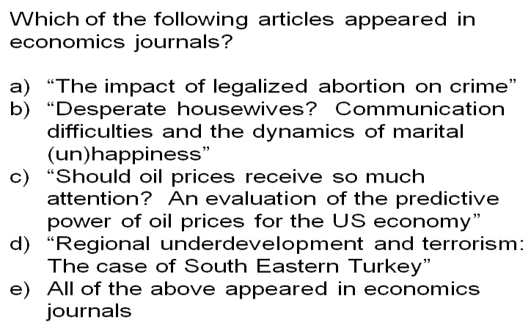
Notes:
Answer: e
Economists study a wide variety of problems
What is more dangerous, a gun or a swimming pool?
Comes from “Freakonomics”
A family couple has a young daughter. She has two friends. The parents of one have a handgun in their house, so she can’t go play there. Parents of the other friend have a pool; she goes swimming in her friend.
US Data → Death by swimming pool: 1 child /11 000 pools
→Death by gun: 1 child/1 000 000 guns
A child is 100 times more likely going to die from a pool than from a gun, but the perception is that a gun is more dangerous.
“Nudge” there is a relationship b/w psychology and economics; psychologists also study how people make decisions (overlap with economists)

Slide 7
Which is more dangerous, gun or swimming pool?
More likely to drown than killed by gun

